Slide 1
Custom Spotify Recommender Engine
By: Joshua, Diyaan, Oliver, Anshuman

Slide 2
Original Model
Recommender by K-Means
Use Spotify database
No outlier changing
Set to 5 clusters
Recommendations made by randomly selecting songs from same cluster
Assumption = songs from same cluster sound similar
Variables considered: "acousticness","danceability","energy","instrumentalness","liveness","speechiness","valence"

Slide 3
Changes
Outliers removed, replaced with mean
Variable number of clusters by elbow method; euclidean distance - Still 5
Same assumption = songs from same cluster sound similar
(same) Variables considered: "acousticness","danceability","energy","instrumentalness","liveness","speechiness","valence"
News Sentiment Integrations
BBC
Adjustable song recommendations

Slide 4
Data Exploration
About the database…
114000 Entries
Songs and song metadata
Incredibly taxing on computer
Histograms: Data plotted
Heatmap: Correlation Matrix Connection

Slide 5
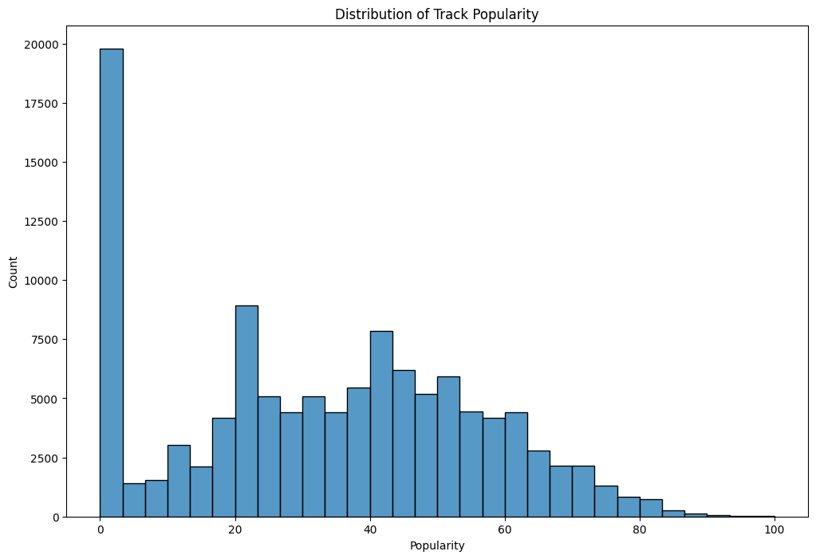
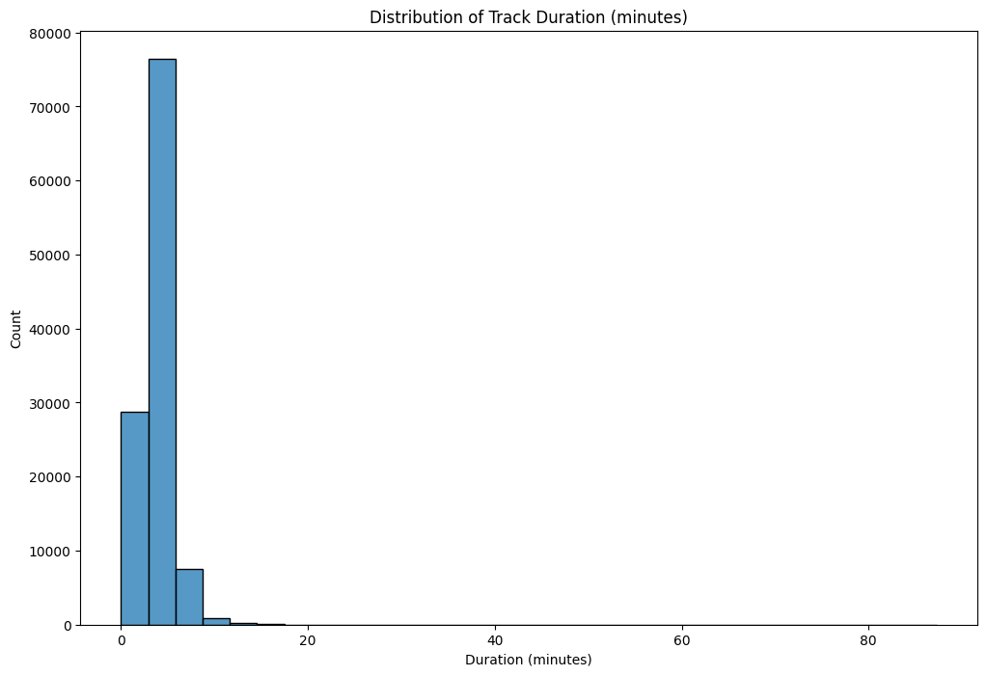
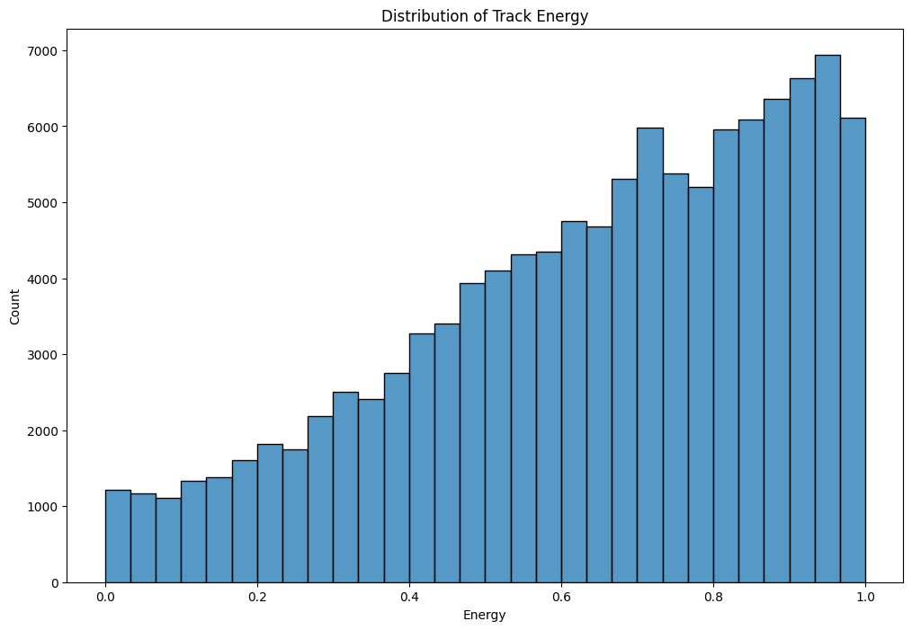
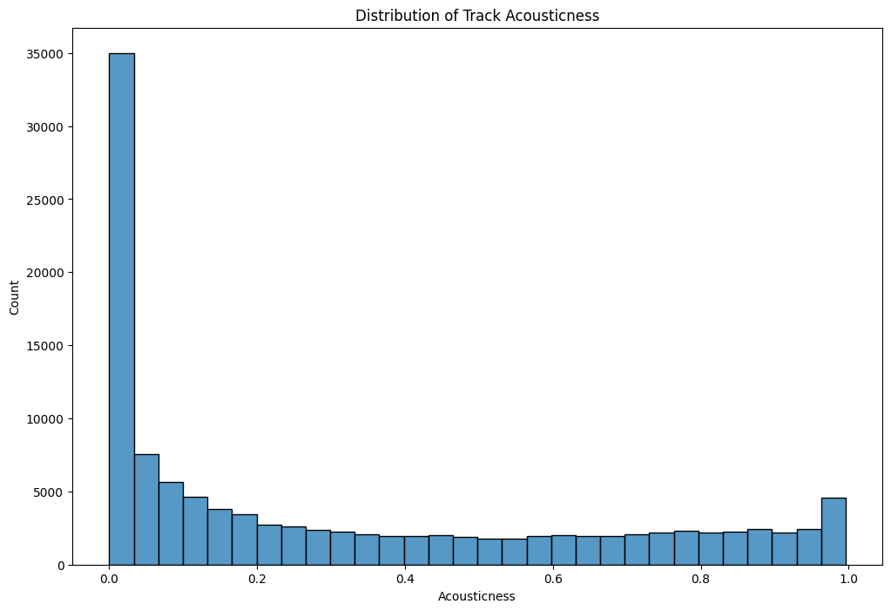
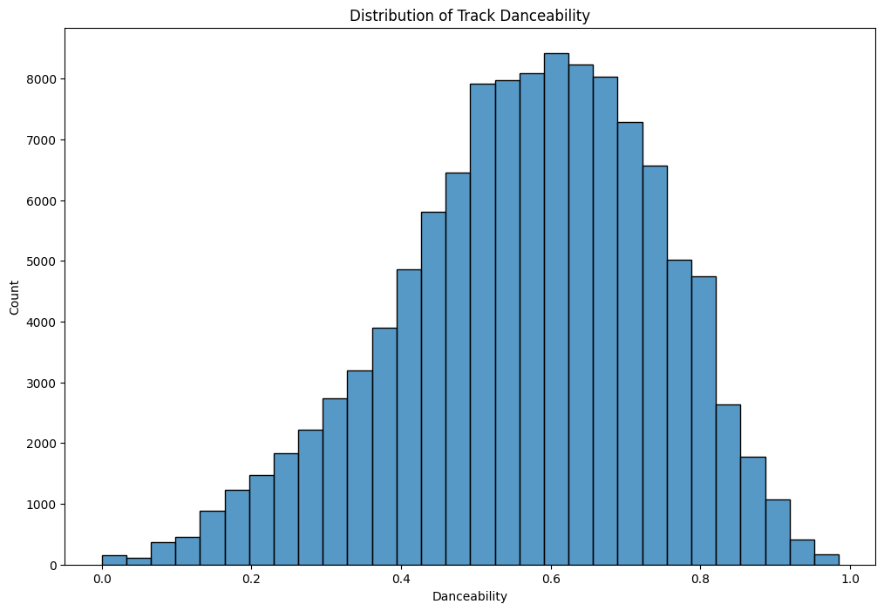
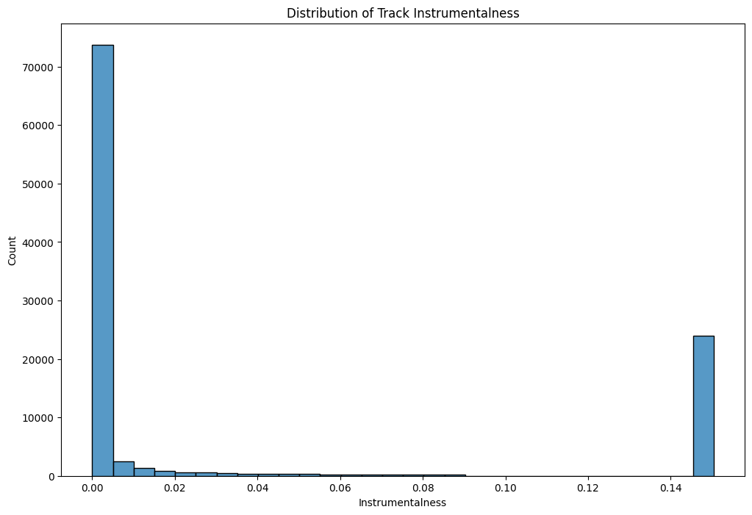
Histograms Analysis for Features!
Histogram Explanations Next
Notes:
Popularity:
Most tracks have lower popularity scores, with a significant number of tracks having popularity close to zero.
There's a smaller peak around the 50-60 popularity range, indicating a subset of moderately popular tracks.
Duration (in min):
The vast majority of tracks have a duration under 10 minutes.
There are a few outliers with significantly longer durations.
Energy:
Energy levels are skewed towards higher values, indicating that most tracks have a high energy level.
Acousticness:
A large number of tracks have very low acousticness, suggesting they are predominantly non-acoustic.
There is also a smaller peak at very high acousticness, indicating some tracks are very acoustic.
Danceability:
Danceability shows a relatively normal distribution, with most tracks having mid to high danceability scores.
Instrumentalness:
Most tracks have very low instrumentalness, suggesting they have vocals.
A smaller subset of tracks have higher instrumentalness values, indicating they are mostly instrumental.

Slide 6
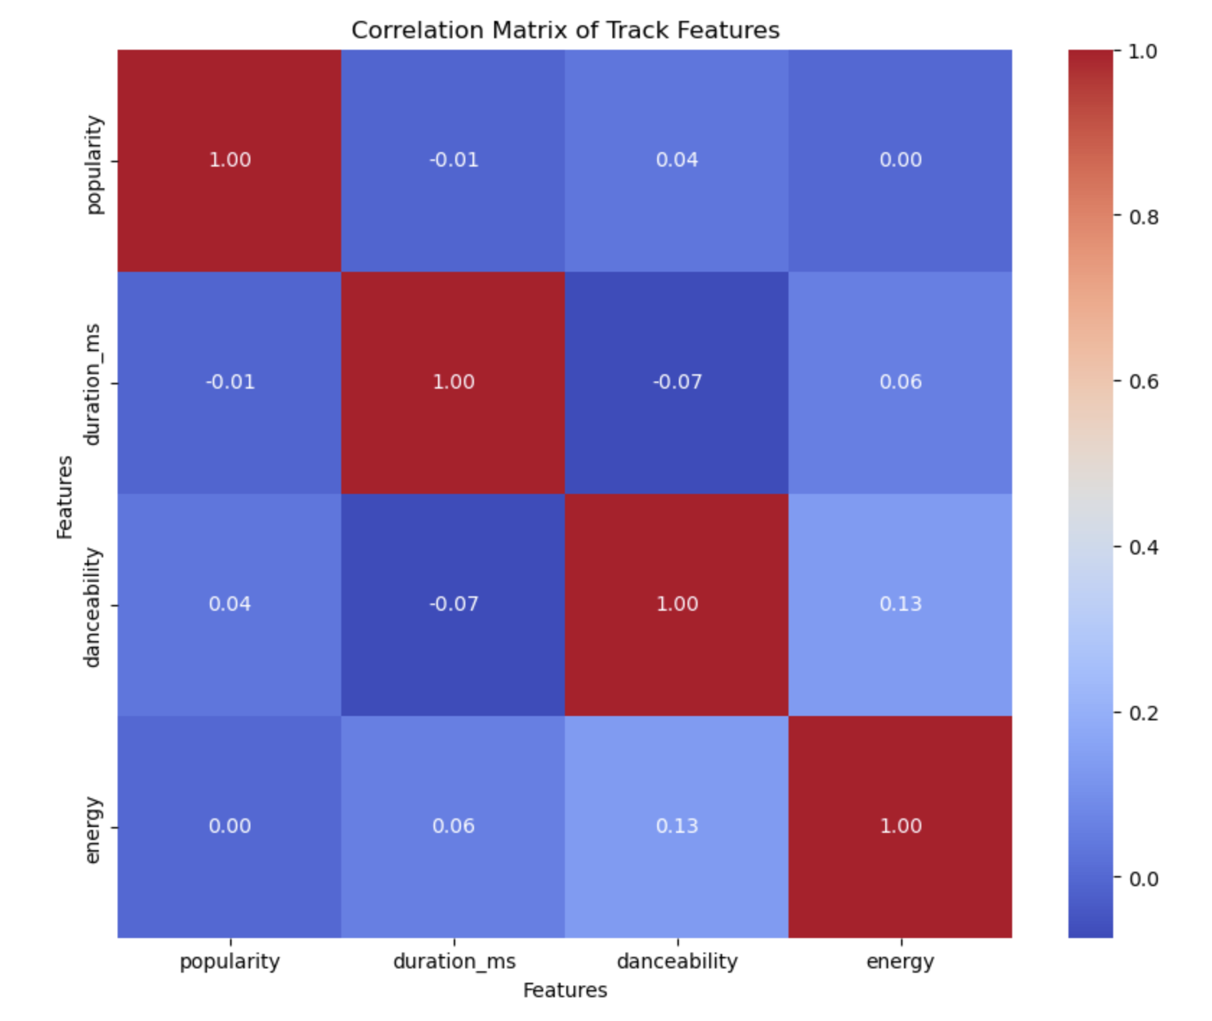
Notes:
This heatmap shows the correlation of other features of the songs. The main correlation that I wanted to look at here was how each feature affected the popularity of the song. From these results we can see that non of the features really have a big impact on the popularity of the songs. Dancabilty being the only one to have an extremely small correlation.

Slide 7
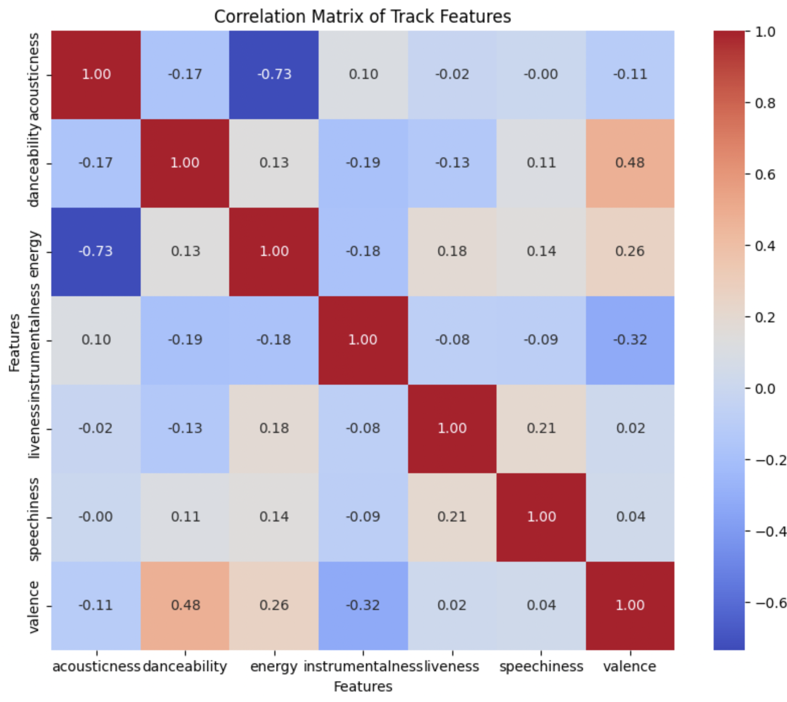
(Relevant musical variables)
Notes:
# The heatmap shows the correlation coefficients between different features. The values range from -1 to 1, where 1 indicates a perfect positive correlation, -1 indicates a perfect negative correlation, and 0 indicates no correlation.
# - There is a strong positive correlation between popularity and danceability, suggesting that popular tracks tend to be more danceable.
# - There is a moderate positive correlation between popularity and energy, suggesting that popular tracks tend to have higher energy levels.
# - There is a weak negative correlation between popularity and acousticness, suggesting that popular tracks tend to be less acoustic.
# - The correlation between duration and other features is relatively weak, suggesting that track duration is not a strong predictor of popularity or other features.

Slide 8
Findings from the Data Exploration Part.
The findings we got from the Data Exploration Part is:
Acousticness vs. Energy: There is a strong negative correlation, tracks that are more acoustic tend to have lower energy.
Danceability vs. Acousticness: There is a slightly a negative correlation, tracks with higher danceability tend to be less acoustic.
Distribution Skew: Many features like popularity, acousticness, instrumentalness show a skewed distribution, often with a large number of tracks clustered at low values.
Feature Correlations: There are significant correlations between certain features that can inform music analysis or recommendation systems. An example is knowing that high energy tracks tend to be less acoustic can help in categorizing or recommending tracks based on listener preferences.

Slide 9
Why K-Means?
DBSCAN is not useful because:
We have defined features, which isn’t what DBSCAN is desnigned for.
Few outliers that were fixed
Defined data shape; regular dataset that has normal dimensionality.
18% Similarity to K-means, while being less efficient.
Agglomerative Clustering is not good because
System couldn’t handle RAM usage, exceeded 12.7 GB
Clusters are large (many songs in 1 cluster)
We couldn't actually calculate accuracy because of processing inefficiency

Slide 10



Comparison of Clustering Techniques
K Means Cluster
Agglomerative
(estimated)*
50.0% Accuracy
DBSCAN Cluster
18% Accuracy
* RAM storage played a huge factor in the ability to run the agglomerative cluster technique.

Slide 11
Cluster Conclusions
With a lack of high dimensionality in the data set, it is smarter to stick with the more efficient and powerful kMeans clustering algorithm.
As shown, utilizing methods that are intended for different forms of data do not fare well accuracy wise while still taking up more storage and time to run.
Took a total of 5 iterations to get the right amount of clusters for the kMeans algorithm to work, which turned out to be the most efficient for the dataset that we were presented with.
Overall, the clustering experiment that we did proved that in order for our project to have any sort of accuracy that is acceptable for a AI model, kMeans was the correct clustering algorithm to use to maximize efficiency and accuracy.

Slide 12
Future User Incorporation
Potential UI / App - Make UI (similar to Spotify) that takes user responses through star system
Implicit User Feedback (number of times played, playlist additions, etc.)
Better news sentiment analysis (other than BBC)

